Slide 1
APOLOGETICS
IN ONE LESSON
almost
Ai1L.net
Lesson 20
“Jesus didn't claim to be God”

Slide 2
Key Takeaways (review)
1
You cannot reject a source merely because they believe their own message; people who claim this are inconsistent
2
Cross examine all sources; and recognize that all are biased (but that doesn’t make them wrong)
3
The broad outline of the Gospel is well-attested by non-Christian sources

Slide 3
Numbers 27 | John 10
(27:16) like sheep who have no shepherd | the shepherd of the sheep (10:2)
(27:20) listen to him | hear his voice (10:3a)
(27:21) at his word they will go out | calls his own sheep by name and he leads them out (10:3b)
(27:17a) will lead them out
(27:17b) who will go out before them | he goes before them (10:4)
(27:17b, 27:21) who will go out before them and who will go in before them. … at his word they will go out and at his word they will come in he and all the children of Israel. | if anyone enters through me, he will be saved, he will go in and out find pasture (10.9)

Slide 4
IDEA IN BRIEF
What?
Be able to show that Jesus is identified as God in many places in the New Testament
Why?
So that people can answer groups (skeptics, Jehovah’s Witnesses, etc.) that argue Jesus never claimed to be God (and possibly do so to cause doubt)
How?
By showing that a solid case case for the divinity of Christ (using the simple H.A.N.D.S. model)

Slide 5
Make an argument that Jesus accepted the honor due to God.
1

Slide 6
Worthy | 4:11 | 5:9, 12
Blessing/praise | 5:13; 7:12 | 5:12, 13
Honor | 4:9, 11; 5:13; 7:12 | 5:12, 13
Glory | 4:9, 11; 5:13; 7:12; 19:1b | 1:6; 5:12, 13 | 29:12
Dominion | 5:13 | 1:6; 5:13
Power | 4:11; 7:12; 19:1b | 5:12 | 29:11
Might | 7:12 | 5:12 | 29:11-12
Wealth |  | 5:12 | 29:12
Wisdom | 7:12 | 5:12
Thanksgiving | 4:9; 7:12
Salvation | 7:10; 19:1b | 7:10
God
The Lamb
God (1 Chron. 29)

Slide 7
Worship Received by Christ Revelation 1:12-20 | Worship Rejected by the Angel Revelation 19-22
Described in detail in glorious imagery (1:13-16) | No description of the angel is given at all (19:12—16)
John fell at Jesus' feet as a dead man (1:17a) | John fell at the angel's feet to worship him (19:10a; 22:8)
Jesus said, "Don't be afraid” (1:17b) | "Don't do that” (19:10b; 22:9a)
Claimed to be “the first and the last” (1:17-18) | Said that he was merely a fellow servant (19:10b; 22:9b)
Jesus does nothing to redirect worship away from himself | Tells John to worship God (19:10c; 22:9c)

Slide 8
Make an argument that Jesus shared the attributes of God.
2

Slide 9
“…two that sit together and are occupied in words of Torah have the Shekinah¹ among them”
rabbi Hananiah Pirkei Avot 3.2
¹ Shekinah refers to the presence of God

Slide 10
“Here Jesus himself fills the role of the Shekinah, God's presence, in the traditional Jewish saying.”
CRAIG KEENER A Commentary on the Gospel of Matthew (page 455)

Slide 11
Make an argument that Jesus shares the names of God.
3

Slide 12
Make an argument that Jesus shares in the deeds that God does.
4

Slide 13
Midst | Walked in "the midst of the sea" (Exod. 14:16, 22, 27, 29) | Boat in the middle of the sea (Mark 6:47)
Crossed Over | Crossed to the other side (Exod. 15:16) | They also "crossed over" the sea (Mark 6:53)
Strong wind | From the east blew Close to daybreak Egyptians found it difficult (Exod. 14:21, 24-25) | Blew from the east Close to daybreak Difficult for the disciples (Mark 6:48)
Hard heart | Egyptians hardened their hearts (Exod. 14:4, 8, 17) | “their hearts were hardened” (Mark 6:52)
Take heart | Moses told the Israelites: "Take heart!” (Θαρσεῖτε, Exod. 14:13 LXX) | Jesus told the disciples: "Take heart!” (Θαρσεῖτε, Mark 6:50)
Exodus
Mark

Slide 14
Make an argument that Jesus shares the seat of God’s throne.
5

Slide 15
“Go to my brothers and tell them, ‘I am ascending to my Father and your Father, to my God and your God.’”
John 20:17

Slide 16
“‘I am,’ said Jesus, ‘and you will see the Son of Man sitting at the right hand of the Power and coming with the clouds of heaven.’ Mark 14:62 | “Here is the Lord’s proclamation to my lord: ‘Sit down at my right hand until I make your enemies your footstool.’” Psalm 110:1
 | “And Jesus said, “I am, and you will see the Son of Man seated at the right hand of Power, and coming with the clouds of heaven.” Daniel 7:13 (ESV)

Slide 17
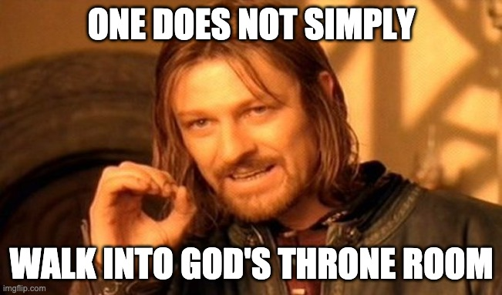

Slide 18
Key Takeaways
1
There are several passages that explicitly say that Jesus is God (including in Mark)
2
There are many passages which make an argument for Jesus’ divinity based on Old Testament references
3
Many statements from Jesus would be incredibly weird if Jesus isn’t God

Slide 19
Sharp’s Rule: (Indicates that both nouns refer to same person)
The—noun—and(και)—noun
Example 1 (one person):
The CEO and chairman …
Example 2 (two people):
The CEO and the chairman …

Slide 20
Sharp’s Rule: (Indicates that both nouns refer to same person)
The—noun—and(και)—noun
Titus 2:13:
our great God and Savior, Jesus Christ …

Slide 21
Sharp’s Rule: (Indicates that both nouns refer to same person)
The—noun—and(και)—noun
2 Peter 1:1:
our God and Savior, Jesus Christ …

